Slide 1
Apache Camel – Training - Day-6
Documented By
Manikanta Jakkampudi

Slide 2
Agenda
JMS and Apache Active-MQ
Sample Project building and test run.
Apache-Camel
Spring-boot
JUnit Test cases

Slide 3
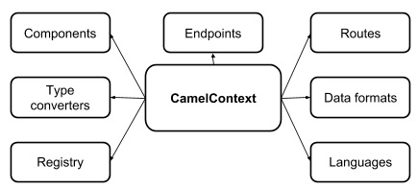
Camel Context
Camel Context

Slide 4
JMS and Apache Active-MQ
What is JMS in Camel Context:
JMS (Java Message Service) is a Java API that allows you to create, send, receive, and read messages.
It also mandates that messaging is asynchronous and has specific elements of reliability, like guaranteed and once-and-only-once delivery.
JMS is the de facto messaging solution in the Java community.
In JMS, message consumers and producers talk to one another through an intermediary - a JMS destination.
And a destination can be either a queue or a topic.
Queues are strictly point-to-point, where each message has only one consumer.
Topics operate on a publish/subscribe scheme; a single message may be delivered to many consumers if they have subscribed to the topic.
JMS also provides a ConnectionFactory that clients (like Camel) can use to create a connection with a JMS provider.
JMS providers are usually referred to as brokers because they manage the communication between a message producer and a message consumer.

Slide 5
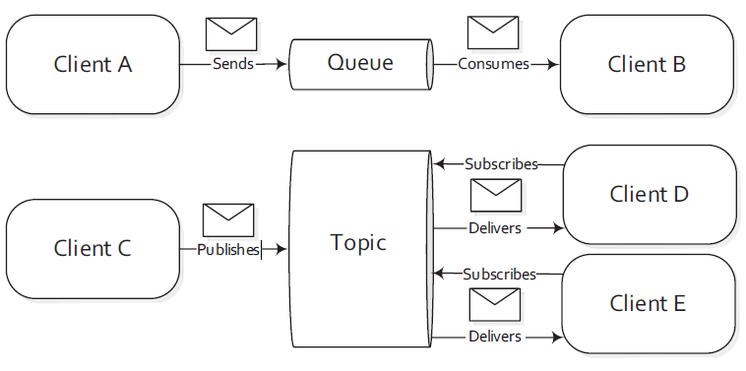
JMS and Apache Active-MQ …Continued
How To Configure Camel To Use a JMS Provider:
In order to connect Camel to a specific JMS provider, it need to configure Camel’s JMS component with an appropriate ConnectionFactory.
Apache ActiveMQ is one of the most popular open source JMS providers, and it’s the primary JMS broker that the Camel team uses to test the JMS component.

Slide 6
JMS and Apache Active-MQ …Continued
Step#1
Create AMQ ConnectionFactory object to connect to Broker:
Apache ActiveMQ, you can create an ActiveMQConnectionFactory that points to the location of the running ActiveMQ broker by
Connect to embedded broker:
ConnectionFactory connectionFactory = new ActiveMQConnectionFactory("vm://localhost");
2. Connect to external broker:
ConnectionFactory connectionFactory = new ActiveMQConnectionFactory(“tcp://<BROKER_IP>:<PORT>");
The vm://localhost URI means that you should connect to an embedded broker named “localhost” running inside the current JVM. The vm transport connector in ActiveMQ creates a broker on demand if one isn’t running already, so it’s very handy for quickly testing JMS applications

Slide 7
JMS and Apache Active-MQ …Continued
Step#2:
Create JMS Component and attach to Camel Context:
Next, when creating CamelContext, just add the JMS component as follows:
CamelContext context = new DefaultCamelContext();
context.addComponent("jms", JmsComponent.jmsComponentAutoAcknowledge(connectionFactory));
The JMS component and the ActiveMQ-specific connection factory aren’t part of camel-code, below dependencies need to be added to POM:
For the plain JMS component, all you have to add is this:
<dependency>
<groupId>org.apache.camel</groupId>
<artifactId>camel-jms</artifactId>
<version>X.Y.Z</version>
</dependency>

Slide 8
JMS and Apache Active-MQ …Continued
The connection factory comes directly from ActiveMQ, so it need the following dependency:
<dependency>
<groupId>org.apache.activemq</groupId>
<artifactId>activemq-camel</artifactId>
<version>X.Y.Z</version>
</dependency>

Slide 9
JMS and Apache Active-MQ …Continued
Step#3
Using URIs to specify the destination:
Once the JMS component is configured, application now can start sending and receiving JMS messages.
Sample URI for a Queue destination:
jms:queue:incomingOrders
Sample URI for a Topic destination:
jms:topic:orderDailyFeed

Slide 10
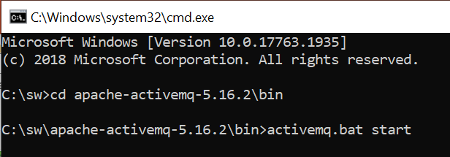
JMS and Apache Active-MQ …Continued
Below steps for AMQ broker administration in development environment:
Step#1: Download the latest/preferred version of Apache Active-MQ server from following link:
https://activemq.apache.org/download.html
Step#2: Once download complete, unzip the file to desired location
Step#3: Open Command prompt and go to the /bin directory in unzipped location.
Step#4: Issue the following command to start the standalone AMQ broker.

Slide 11
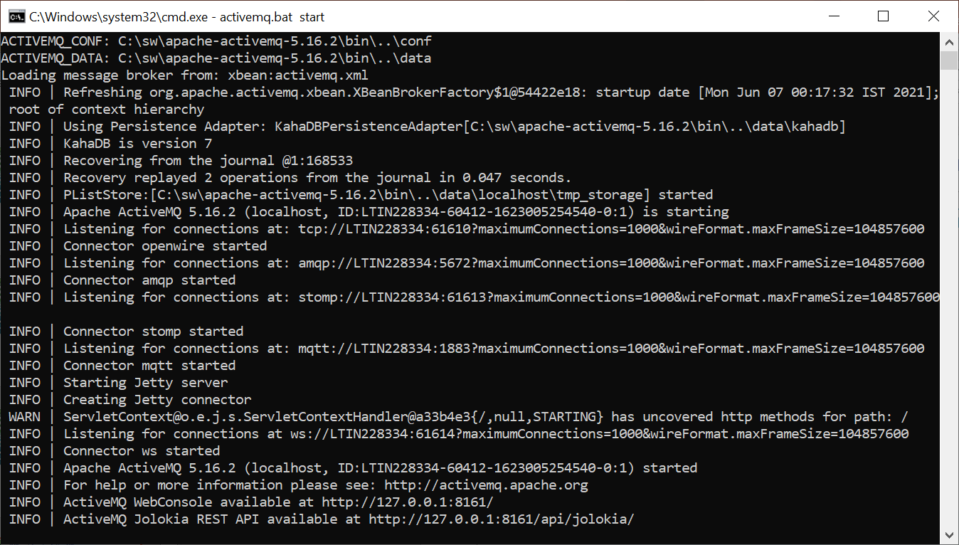
JMS and Apache Active-MQ …Continued
Step#5: Verify the broker started normally with default configuration using the following URL from local setup, if server starts normally then this web URL will be accessible from local setup..

Slide 12
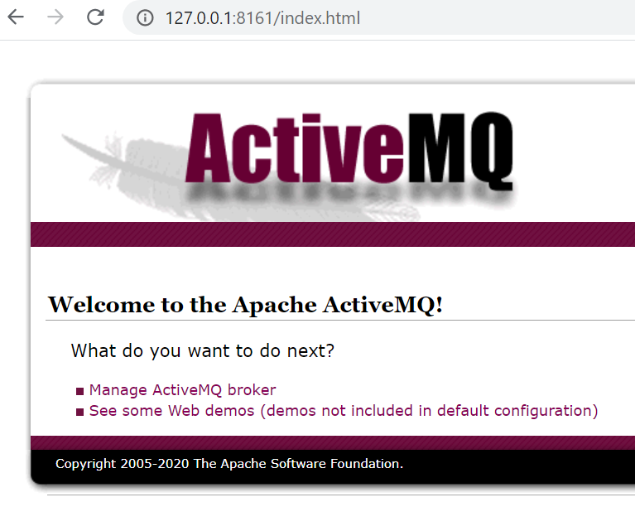
JMS and Apache Active-MQ …Continued
AMQ web console page:
http://127.0.0.1:8161

Slide 13
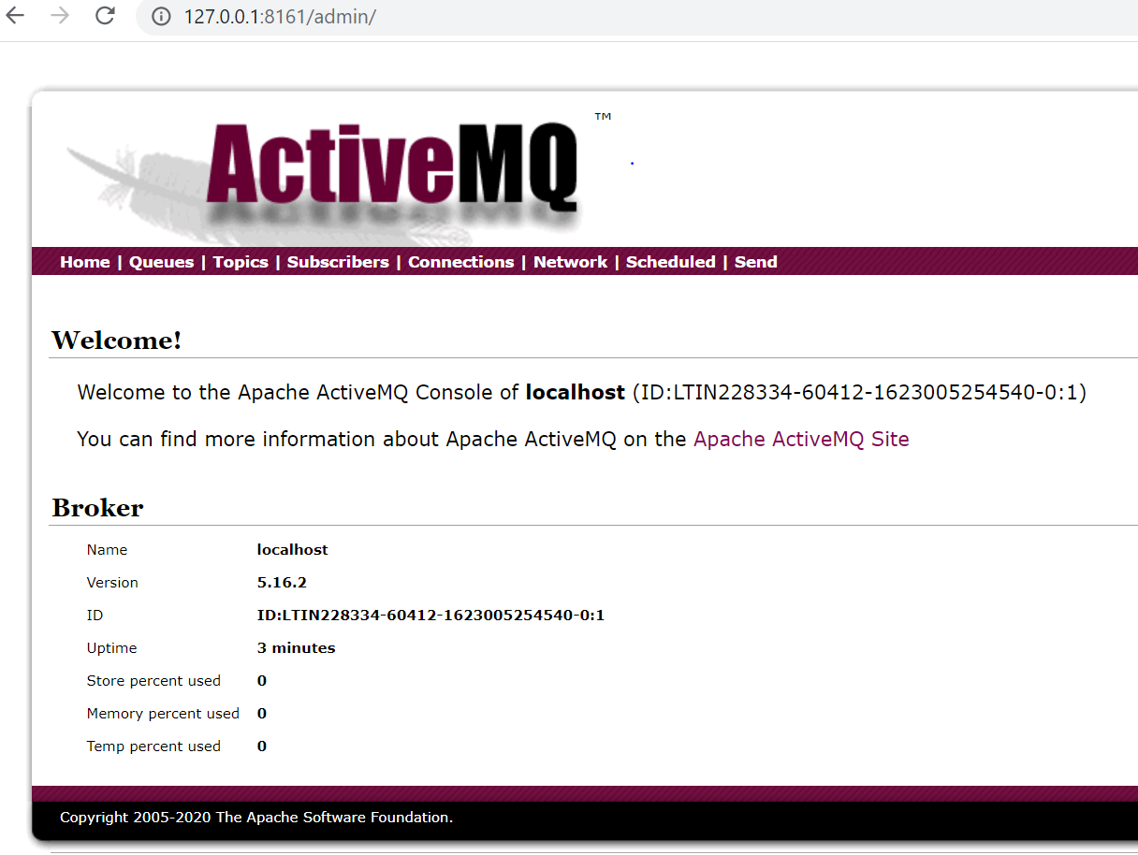
JMS and Apache Active-MQ …Continued
AMQ web console page:
After clicking on Manage ActiveMQ broker link on home page:

Slide 14
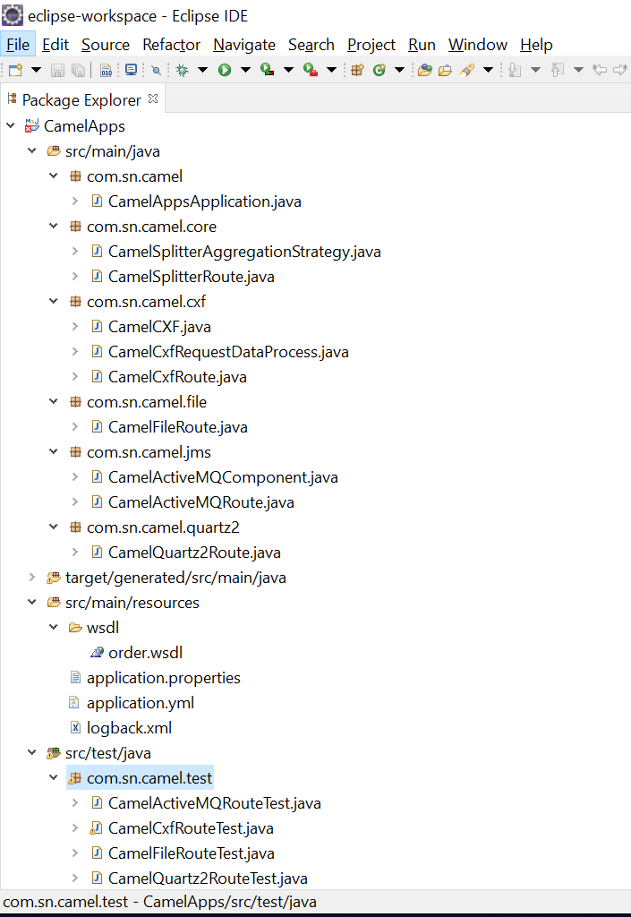
Sample project page
Below a sample project created using Apache-camel, Spring-boot and Junit test cases:
Use following Maven goal at command prompt to test run: mvn test

Slide 15
Thank You

